Slide 1
SAP FI
Accounts Payable

Slide 2
Table of contents
  AP Overview
  Sub Processes
    Master Data
    Invoice Processing
    Payments / Disbursements
    Account Analysis / Reconciliation
    Periodic Processing
    Reporting

Slide 3


SAP Modules - Overview
SD
FI
Sales &
Distribution
Financial
Accounting
MM
CO
Materials
Mgmt.
Controlling
PP
AM
Product
Planning
Fixed Asset
Mgmt.
SAP R/3
QM
PS
Quality
Mgmt.
Project
System
PM
OC
Plant Maint.
Office &
Comm.
HR
IS
Human
Resources
Industry
Solutions

Slide 4
FI – Financial Accounting Modules
FI - Financial Accounting Modules
General Ledger
GL
Special Ledger
Accounts Receivable
AP
SL
AP
Legal
FI
Accounts Payable
Consolidation
LC
AR
TM
CM
Travel
Management
AM
&
IM
Cash Management
Asset and Investment
Management
Notes:
Page <number>
HR
HR07: HR PAYROLL

Slide 5
Accounts Payable Process Overview
Financial
Accounting
Process decompositions are the starting point for process documentation.
They summarise what is involved in a the AP process at a high level
Accounts Payable
Master
Data
Invoice
Processing
Sundry
Logistics
Payments / Disbursements
Account Analysis & Reconciliation
Periodic
Processing
Reporting

Slide 6
Master Data
Maintenance
  Creation 3 Levels
    General Data (name, address)
    Company Data (reconciliation acct, payment term)
    Purchasing Data (PO currency, incoterms)
  Change
  Block
  Delete
Account Groups
Intercompany
One-time vendors
Notes:
Page <number>
HR
HR07: HR PAYROLL

Slide 7
Master Data: Structure
Client
230
General data
  Address
  Control data
  Payment Transactions
Company Code data
  Account Management
  Payment Transactions
  Correspondence
Purchasing Organization
  Purchasing Data
  Partner functions
Vendor
Master
Company
Code 9100 A Ltd.
Purchasing Organization:
9100 A Purch.Org.
Notes:
Page <number>
HR
HR07: HR PAYROLL

Slide 8
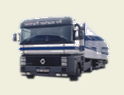

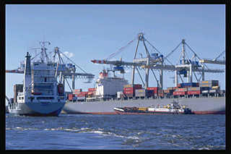
Master Data: Account Groups
Local Vendors
Groups Implemented
GEV
OTV
AFV
One-Time Vendor
0005
Foreign Vendors
SWV
Notes:
To create a master record, you have to specify an account group. The account group cannot be changed after you have created the master record.
The account group determines:
How the account is numbered.
A number interval from which the account number is chosen,
Which fields are displayed when you create or maintain vendor master data and whether the entry is optional or required (field status) when you enter or change vendor master data. E.g. when setting up an Employee as a vendor, purchasing data is not required.
Whether the account is a one-time account.

Slide 9
Master Data: Number Ranges
Groups Implemented
Number
Ranges
GEV
0005
01 0000100000 0000299999
02 0000300000 0000399999
03 0000400000 0000499999
ZZ 1000000000 1999999999
OTV
AFV
SWV
Notes:
The SAP R/3 system works on the principle of numbers, as opposed to names, for master records.
Each master record has a unique number. You need this number to display or change the master record and to post to the vendor account.
The vendor master record number is assigned automatically by SAP R/3 in sequential order or manually in the case of account group SWV (external / internal number assignment).
SAP R/3 ensures that the numbers assigned are always unique, the system selects the next number from the interval. When the account number is entered manually, SAP R/3 checks the number against existing vendor master records.
A vendor account has the same number for all company codes.
The account group determines what the valid number interval for a vendor master record is.

Slide 10
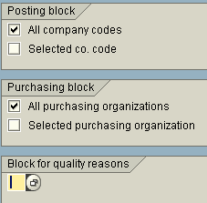
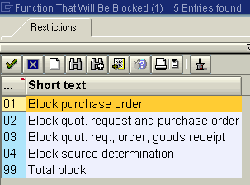
Master Data: Blocking a Vendor
Vendor master record can be blocked in the following areas:
  Posting block,
  Purchasing block
In addition user may specify reason for blocking
Notes:
When you block an account centrally, you can prevent both posting and order processing.
On the initial screen, you can specify the areas that you need to block by entering the company code and purchasing organisation. If you do not specify the key for an area, the corresponding block fields are not set.
Enter the vendor account number and the company code. Optionally enter the purchasing organization.
To block posting, select the company code of the displayed vendor master record or select all company codes by clicking in the corresponding field.
To block purchasing, select either the displayed purchasing area or all purchasing organisations by clicking next to the corresponding field.

Slide 11
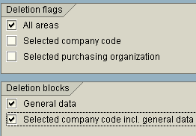
Master Data: Mark for Deletion
All data in this master record is to be deleted.
Deletion is done by archiving program, provided that there is no dependent data on vendor account.
Notes:
You can archive vendor account master records that you no longer need. Vendor master records may not be archived immediately. For you to archive a customer master record, the following requirements must be met:
The account cannot contain any transaction figures in the system. Transaction figures from prior years that have not been archived will prevent the system from deleting the account master record.
The account must be marked for deletion in its master record.
You should block an account for posting before you mark it for deletion. The only effect this deletion indicator has is to cause a warning to be issued every time you subsequently try to post to this account.
You can set the deletion flag for all company codes or just one specific company code. You can reset a deletion flag at any time as long as the master record has not been physically deleted from the system (provided you are authorized to do so).
If all open items in the vendor account you are deleting are cleared, you should block it for posting so that other users cannot post to it.

Slide 12
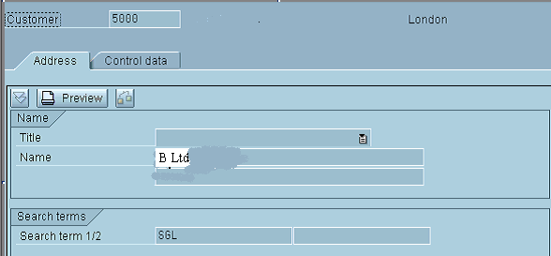
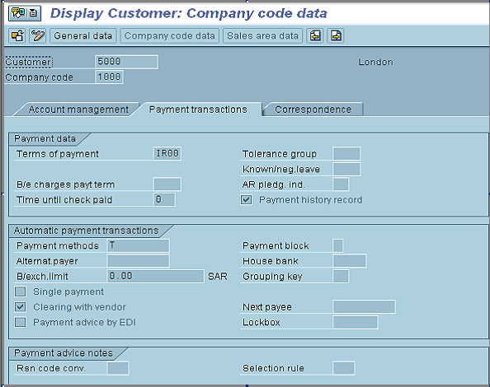
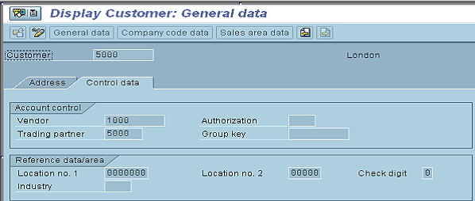
Master Data: Intercompany
Notes:
Page <number>
HR
HR07: HR PAYROLL

Slide 13

Master Data: One-time Vendor
We use One-time Vendor Master Record to avoid large number of unnecessary master data
Every time we enter a business transaction, the systems stores the specific Master Data information separately in the document
Notes:
One-time vendors are used for vendors with whom we rarely or only once perform business with.
In contrast to other vendor master records, a one-time vendor master record is used for several vendors, so that you do not have to create a large number of vendor master records that are used only once. As a result, you do not store any vendor-specific data in the vendor master record for one-time accounts.
When you post an invoice to a one-time account, SAP R\3 automatically goes to a master data screen. In this screen, you enter the specific master data for the vendor, e.g. name, address, which is stored separately in the document.
You create, display, block, and delete one-time vendor master records in the same way as all other vendor master records.

Slide 14
Accounts Payable Process Overview
Financial
Accounting
Process decompositions are the starting point for process documentation.
They summarise what is involved in a the AP process at a high level
Accounts Payable
Master
Data
Invoice
Processing
Sundry
Logistics
Payments / Disbursements
Account Analysis & Reconciliation
Periodic
Processing
Reporting

Slide 15
Invoice Processing
Business Transactions included in Process:
Sundry
  Invoice
  Credit Memo
  Down Payment (Special G/L)
  Foreign Currency
  Cancel/Reverse Document
  Inter-company (Idoc’s)
Notes:
Page <number>
HR
HR07: HR PAYROLL

Slide 16
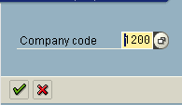
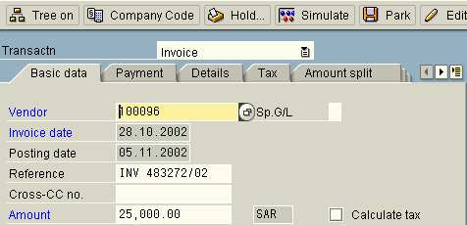
Document Entry – Basic Data
Enter company code
Screen Tab
All required data on one screen,
A user can use “tabs” to switch between sub-screens
Notes:
The Enter Invoice screen consists of five standard tabs:
Basic data
Payment
Details
Tax
Notes
On the basic data tab, enter general data about the invoice and vendor, e.g. vendor number, invoice amount, invoice date.

Slide 17
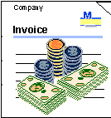
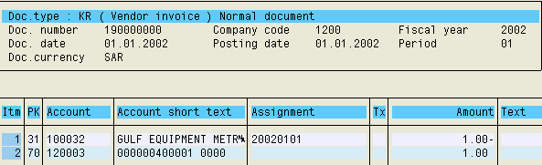

Posting a document
OR
Document
Simulation
Notes:
After entering the document it is possible:
To post it immediately
To “park” the document
To hold the document

Slide 18


Parked doc. vs. Held doc.
Park document:
  Assigned number (according to document type)
  Available for many users (depending on authorizations in the system)
Held document:
  Internal document number (defined by the user)
  Available only for the user who created it.

Slide 19
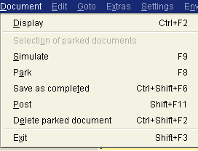
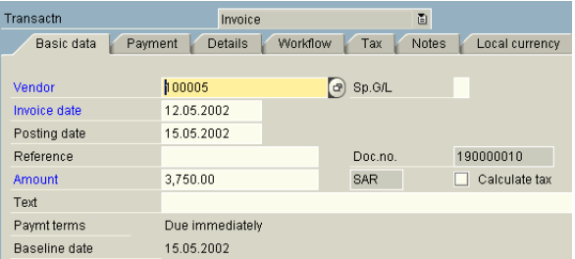
Processing of Parked Documents
Save the document
The parked document may be:
  Posted,
  Edited,
  Saved as completed,
  Deleted.
Edit your document
Notes:
If you know the parked document’s details, enter the document number, company code and fiscal year on the Initial screen.
Alternatively, click the List button, which takes you to a selection screen. On the Document List screen, enter the selection criteria, then click the Execute button

Slide 20
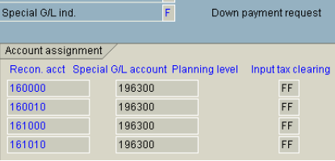
Special GL Transactions: Definition
Special GL Indicator
Vendors’ reconciliation accounts
Accounts defined for Special GL Transactions
Special GL Transactions allow the user to post the document to an alternative GL account instead of “normal” Vendor reconciliation account,
They are defined in Customizing for Vendor and Customer reconciliation accounts,
Customer / Vendor account balances are not affected.

Slide 21
Posting a Down Payment
Vendor Account
GL Down Payments
Bank Account
1
10
1
10
10
A Ltd pays the vendor a down-payment: $10.000,-
The down payment is booked on Vendor account with a Special GL indicator
The amount of $10.000,- is shown on Vendor account, but on different GL Account, instead of Vendor reconciliation account
Notes:
Except of “normal” special GL transactions, in the system there may be defined “noted items”. If the special GL transaction is defined as “noted item” then postings with this indicator do not lead to an update of the transaction figures.
A typical example of a noted item is a “Down Payment Request”. A transaction entered with this indicator stores only an information in the system (no “real posting takes place).
This document (down payment request) is used later to post automatically a down payment and create a payment document.

Slide 22
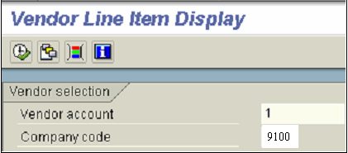
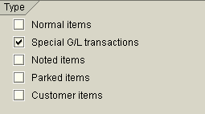
Display of Special GL Transactions
Transaction code: FBL1N - Line item Display
To display the transaction posted with Special GL Indicator, mark the relevant field on the “Line items display” screen.
“Dynamic selections” may be used to search for different GL indicators.

Slide 23
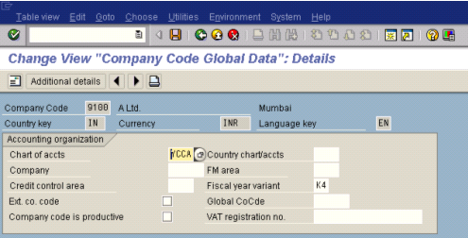
Posting in Foreign Currency
For every Company Code there’s defined a company code currency,
Every document, posted in different currency than CC currency, is processed as a foreign currency document.
Notes:
The company code currency is defined in SAP as a local currency
If the GL account currency = CC currency, then the posting can be done in any currency. Otherwise, the posting can be done only in the currency that has been defined for this particular GL account.

Slide 24
Posting in Foreign Currency (2)
Document header
Exchange rates
Currency/rate USD 43.5
Amount 1,000
Translation date
09.30.05
08.15.05 USD INR 43.60
09.30.05 USD INR 43.50
Line items
Amount FC: 1,000.00 USD
Amount LC: 43500 INR
Notes:
When you post an item in a foreign currency, you enter the appropriate foreign currency key in place of the local currency key that is defaulted by the system. The currency key is entered in the Currency/Rate field of the document header. The system stores the amount in both local currency and foreign currency in each line item and checks whether the currency key has been defined and is therefore permitted.
You will normally use an exchange rate defined in the exchange rate table. The system defaults the posting date as the translation date, and this translation date determines which exchange rate is taken from the exchange rate table.
The amount need be entered in only one currency; since the system translates this amount into the other currency automatically. In the line items, all amounts are saved in both currencies. These include the posting amount, tax amount, and cash discount amount.
The currency exchange table can be overridden by entering an exchange rate manually (in the document header), or entering the local/foreign currency amount at line item level. The translation date can also be entered manually to override the document date.

Slide 25
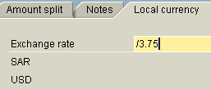
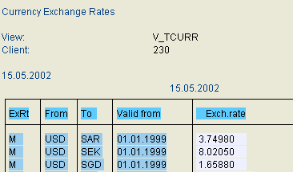

Posting in Foreign Currency (3)
1.
2.
3.
1. Exchange rate can be entered manually,
2. Or derived from “Exchange Rates Table”
3. System automatically translates the foreign currency into CC currency.
Notes:
When you post an invoice in a foreign currency, you enter the appropriate foreign currency key in place of the local currency key, USD that is defaulted by the SAP R/3. The system stores the amount in both local currency and foreign currency in each line item and checks whether the currency key has been defined and is therefore permitted.
The amount is entered in only one currency, as the system translates this amount into the other currency automatically.
Normally you will use the exchange rate defined in the exchange rate table.
If the exchange rate on the invoice is different than default daily rate the currency exchange rate table can be overridden by entering an exchange rate manually (in the document header), or entering the local/foreign currency amount at line item level.

Slide 26
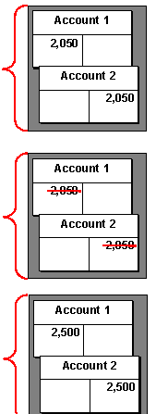
Reverse an AP document
Document entered incorrectly
Document corrected by Reversal:
  Reverse with a standard reversal posting
  Reverse with a negative posting
Document re-entered correctly
Balance sheet
Assets
Liabilities
Shared equity
Notes:
“Nobody’s perfect”. As a result, the document created may contain incorrect information.
The system provides a function to reverse G/L, A/R and A/P documents both individually or in mass process.
A document may be reversed either by:
entering a standard reversal posting or
entering a negative posting.
To reverse a document user must enter the reason code.
Documents with cleared items cannot be reversed. The clearing document must first be reset.

Slide 27
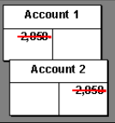
Mass Reversal of Documents
Mass Reversal Procedure
Many documents may be reversed at the same time,
Process may be scheduled to be performed in the background.

Slide 28
Inter-company Processing
Inter-coy Billing
AR header reference
=
AP header reference
Invoice (IV)
SD Document
2000002244
HDR Ref:
2000002244
A Ltd
AP
Inter-coy Billing
AR
Invoice (IV)
SD Document
1000001144
HDR Ref:
1000001144
A1 Ltd
F110
FI Document
3000015244
HDR Ref:
2000002244
AP
AR
A2 Ltd
FI Document
2000006344
HDR Ref:
1000001144
F110
AR header reference
=
AP header reference

Slide 29
Invoice Processing continued…
Business Transactions included in Process:
Logistics
  Invoice Receipt
    Overview
    Subsequent DR’s / CR’s
    Delivery Costs (Planned / Unplanned)
  Credit Memo
  Evaluated Receipt Settlement (ERS)
  Consignment / Pipeline Settlement
Notes:
Page <number>
HR
HR07: HR PAYROLL

Slide 30

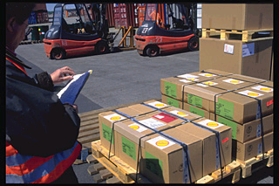

Procurement Cycle
Purchase
requisition
8
1
Payment
processing
Determination
of reqmts.
Invoice
Purchase
order
Quotation
10
10
Invoice
verification
7
2
20
Source
determination
20
Goods
receipt
6
3
Vendor
selection
Purchase
order
10
PO
processing
20
PO
monitoring
5
4
Notes:
The procurement environment involves a number of steps:
A material shortage is identified.
The source of the required material is determined through external procurement (purchasing) or in-house (through production or from inventory). If the item is externally procured, the rest of the procurement cycle follows.
The purchase requisitioner creates a purchase requisition and sends it to the buyer.
The buyer identifies the supplier through a tender process (request for quotation) or other sourcing agreement.
The buyer creates the purchase order and monitors the order.
The goods arrive and a goods receipt note is checked against the purchase order. Under/over deliveries are recorded, and certain procedures are followed.
The invoice arrives and is checked against the purchase order and the goods receipt note. If it is in accordance with the terms of supply, it is cleared for payment.
The invoice is paid on due date.

Slide 31
Accounting Entries
Cost Element Object
GR/IR
Acc. Payable
1.
2.
1.
3.
2.
Bank Clearing Account
Bank
1. Goods received.
2. Invoice received.
3. Vendor paid.
4. Bank account credited/charged
4.
3.
4.
Notes:
Page <number>
HR
HR07: HR PAYROLL
A purchase order must be created and released before goods received can be booked in against it.
A goods receipt note, referencing the PO will debit the cost object (or materials received/stores), and credit the GR/IR clearing account.
When the invoice is captured, the accounting entries are debit and clear the GR/IR clearing account and credit accounts payable.
The payment run will debit the vendor account and credit the bank clearing account.
Finally, when the bank statement is posted, the bank account is credited and the bank clearing account is debited.

Slide 32
Invoice Verification (Three Way Matching)
Master data
Invoice verification
Invoice document
Invoice
Payment program
Check Discrepancies
Purchase order
Goods receipt
Notes:
Page <number>
HR
HR07: HR PAYROLL
SAP R/3 checks the invoice information against the relevant purchase order and goods receipt note to ensure that there are no quantity and price discrepancies.
If there are discrepancies, the invoice is blocked and the information is sent to the buyer responsible for the purchase order.
The buyer investigates the discrepancies and when resolved the accounts payable supervisor unblocks the invoice.
When an invoice is posted and verified, the following occurs:
The system automatically determines the accounts to be posted to and the amounts for posting. This information comes from Account Determination in Purchase Order and Purchase Requisition.
The system creates an MM invoice document, and an FI document which is used in the Financial Accounting and Controlling modules. Both documents will be given the same number.
After the invoice has been posted, the document appears as an open item on the vendor account (line item display).

Slide 33

Display Purchase Order
Purchase orders are the actual requests for a vendor or a plant within A Ltd. to deliver materials and or services based on predefined agreements (e.g. contract or quotation). Use TCode ME23N to display PO.
Purchase Requisition
Purchase Requisition
Purchase Requisition
Purchase Requisition
Purchase Order
10
20
30
Purchase Requisition
10
20
30
Purchase Requisition
10
20
30
10
20
30
10
20
30
10
20
30
10
20
30
Vendor
Source
Assignment

Slide 34
A Vendor Invoice
The user must enter the following data:
  document date, purchase order number
  invoiced amount, terms of payment (if necessary)
The following items are copied from the purchase order:
  vendor, terms of payment, invoice items
The following items are transferred from the purchase order history:
  quantity, amount
  account determination.
The bank information is stored in the vendor master record.

Slide 35
Parking a Vendor Invoice
You can park or hold an invoice before posting it. When you save the document, the system creates an unposted document that only contains the data on the initial screen such as the gross invoice amount, tax amount, terms of payment and allocation, but no item data.
Later you can use the “Invoice overview” function to change and post the parked / held document
Notes:
Caution: you can delete parked document, but the number of the deleted document is not re-issued!
The parked document will keep the same number after posting (both documents use the same number range).

Slide 36
Subsequent Debit / Credit
1
PO History
Invoice for PO 456
100 pcs - 300 INR
100 pcs 300 INR
2
Invoice for PO 456
150 pcs - 450 INR
50 pcs 150 INR
3
Invoice for PO 456
Subsequent costs
150 pcs - 480 INR
50 pcs 30 INR
Notes:
A subsequent debit/credit changes the total invoice value of a purchase order item; the total invoice quantity remains unchanged.
An invoice must be entered as a subsequent debit if a purchase order item has already been invoiced and further costs are incurred. (For example, a vendor has inadvertently invoiced you at too low a price and then sends a second invoice for the difference.)
You must enter a credit memo as a subsequent credit if a purchase order item was invoiced at too high a price and now you have received a credit memo. (For example, a vendor has inadvertently invoiced you at too high a price and then sends a credit memo for the difference.)
If you enter a subsequent debit/credit, the R/3 System suggests the entire invoiced quantity, but no value. The maximum quantity that you can subsequently debit or credit is the quantity that has already been invoiced.
You can enter a subsequent debit/credit for a purchase order item only if an invoice has already been posted for that item.
A subsequent debit/credit cannot refer to a specific invoice.
Subsequent debits or credits are flagged in the purchase order history.

Slide 37
Subsequent Debit / Credit - Posting Rules
When you post a subsequent debit/credit, the invoice amount is posted to the vendor account.
If the quantity to be subsequently debited or credited has already been delivered, the system makes the offsetting entry to the stock account or the price difference account, depending on the type of price control used. For purchase order items with account assignment, the system makes the offsetting entry to the cost account.
If the quantity to be subsequently debited or credited has not yet been delivered, the R/3 System makes the posting to the GR/IR clearing account. When you post the goods receipt, the system debits/credits the stock account or the price difference account, depending on the price control used. (Note: Generally always GR based IV followed)

Slide 38
Delivery Costs
Purchase order 123
Purchase order 456
100 pcs 10 INR
100 pcs 10 INR
Freight 1 INR/pc
Freight -
Delivery costs
Unplanned costs
Delivery
100 pcs 1000 INR
100 pcs 1000 INR
Freight 100 INR
Freight 100 INR
Total: 1100 INR
Total: 1100 INR
Delivery costs can be divided into:
  Planned delivery costs
  Unplanned delivery costs
Notes:
Planned delivery costs are entered at item level in the purchase order.
Planned delivery costs can be divided into:
Freight costs
Customs
Delivery costs can be invoiced in the following ways:
Fixed amount, independent of scope of supply
Quantity-dependent amount
Percentage of value of goods to be delivered
Unplanned costs are entered at invoice receipt.
The system posts the costs to a separate G/L account.

Slide 39


Planned Delivery Costs - Postings
Invoice with reference to the PO
MIRO
Accounting Document
For planned delivery costs, the postings are made to a clearing account at goods receipt. There are separate accounts for costs of different origins.
If the delivery costs in the invoice differ from the planned delivery costs, the differences are posted in the same way as for normal price and quantity variances.

Slide 40



Unplanned Delivery Costs - Postings
MIRO
Accounting Document
Notes:
Unplanned delivery costs referencing back to Purchase Orders have important implications. The system distributes the costs over the materials on the basis of invoiced value. The system then determines the accounts to which the costs must be posted from the Purchase Order:
In the case of direct cost material, the costs are posted to the cost object.
In the case of stock material, the system allocates the cost to the material in stock, provided there is a greater quantity in stock than in the PO. If there is insufficient stock coverage, the remaining cost is posted to a Price Difference account.

Slide 41

Credit Memo
Purchase order 123
Credit Memo
100 pcs 10 INR/pc
80 pcs 800 INR
30 pcs 300 INR
Goods Receipt: 50 pcs
Purchase order 123
Subsequent Credit
100 pcs 10 INR/pc
50 pcs 800 INR
50 pcs 300 INR
Notes:
You usually receive a credit memo from a vendor if you were overcharged.
A credit memo can be entered with reference to a purchase order or a goods receipt.
If you enter a credit memo for a purchase order item because the vendor has invoiced you at too high a price, you must post the credit memo as a subsequent debit/credit. The total quantity invoiced for the purchase order item remains the same; the total value invoiced is reduced.
When you post a credit memo, the account movements are made according to the same rules as when you post an invoice. The R/3 System posts to the same accounts, but with the opposite +/- sign next to the entry.

Slide 42
Evaluated Receipt Settlement
In Evaluated Receipt Settlement (ERS), goods receipts are settled (posted) directly without the vendor having to issue an invoice.
To generate vendor invoice the system uses information from the purchase order and the goods receipt.
The following prerequisites must be met to use ERS functionality:
  The goods receipt must refer to a purchase order.
  Goods-receipt-based Invoice Verification must be defined for the purchase order item.
  The order price of the materials may not be an estimated price
  The Vendor master record must be flagged as being subject to ERS.
Notes:
The system creates a message record at the time of settlement, which allows you to send the vendor a letter about the settlement.
ERS is defined for each purchase order item. The R/3 System supports the buyer by suggesting information from the vendor master record and the purchasing info record.
You can narrow down the selection of goods receipts for settlement in several ways – for example, by goods receipt posting date, by vendor, or by purchase order.
You can set the following options for the creation of invoice documents:
One invoice document per vendor
One invoice document per purchase order
One invoice document per purchase order item
One invoice document per delivery document/service entry sheet
If the invoiced quantity is greater than the delivered quantity because of returns, the R/3 System creates a credit memo during ERS.
You cannot use ERS to settle delivery costs.

Slide 43
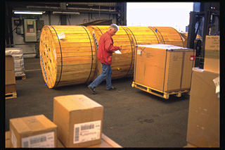
Evaluated Receipt Settlement (2)
Purchase Order
Goods Receipt
Vendor Invoice
Purchase Order
10
20
30
Goods receipts are settled automatically.
The system posts the invoice document automatically on the basis of the data in the purchase order and goods receipts.
This way you can eliminate invoice variances.

Slide 44
Pipeline Settlement
Bill of Materials
Goods Receipts
Vendor Invoice
PIPE Material
10
20
30
PIPE Material
10
20
30
Dt Accruals
Ct Vendor
A Ltd. have pipeline materials as part of their Bill of Material,
There’s no invoice from the vendor for goods withdrawals,
Instead, A Ltd. will settle posted withdrawals, issue a statement of the settlement and send it the vendor.

Slide 45
Accounts Payable Process Overview
Financial
Accounting
Process decompositions are the starting point for process documentation.
They summarise what is involved in a the AP process at a high level
Accounts Payable
Master
Data
Invoice
Processing
Sundry
Logistics
Payments / Disbursements
Account Analysis & Reconciliation
Periodic
Processing
Reporting

Slide 46
Payments / Disbursements
Business Transactions included in Process:
Manual payments
Automatic Payment Run
Outgoing Payments
  Reports
Inter-company Payments
  IDoc’s (REMADV)

Slide 47
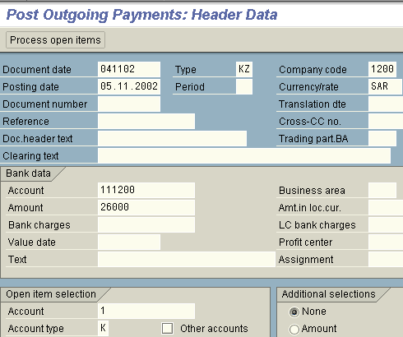
Manual outgoing payment
Open items
This transaction is being used to post vendor outgoing payments that have not been cleared by the automatic payment program,
All data on one screen, no posting keys required.

Slide 48
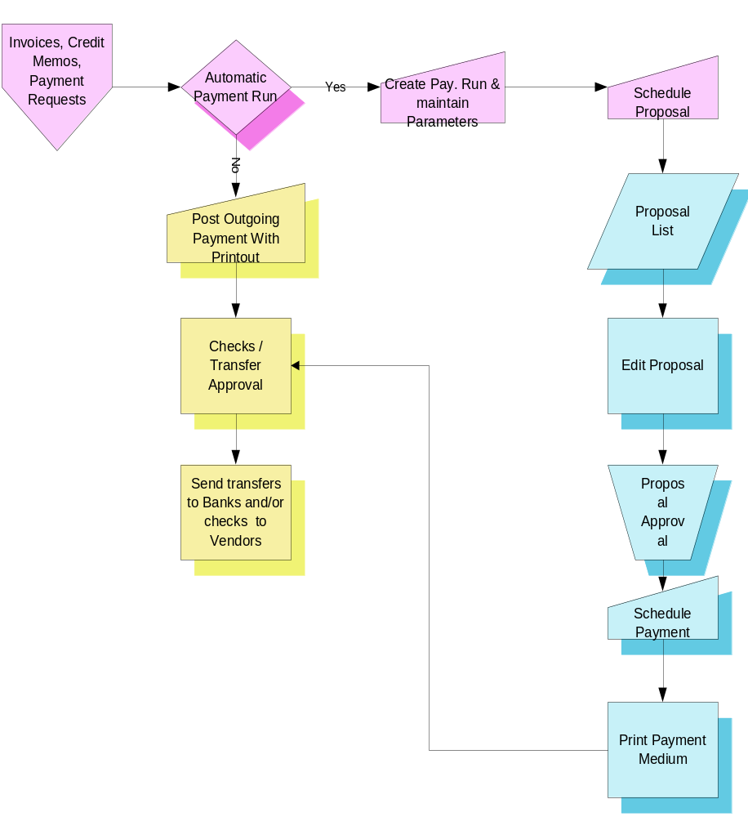
Automated Outgoing Pay.-Activity Flow
Notes:
The payment program can be customized to process both domestic and international payment transactions with vendors and prepare required files / documents.

Slide 49

Automatic Payment Process
Invoices or payment requests are
entered
Payment
documents
are printed
Open invoices are
analysed
Invoices are paid
Invoices are
proposed for
payment
Payments are
approved
Payments are
modified
Notes:
Page <number>
HR
HR07: HR PAYROLL
The automatic payment program is functionality implemented to manage outgoing payments.
SAP R/3 gives users the options to automatically:
Select open invoices to be paid or collected.
Post payment documents.
Print payment media or generate electronic data interchange (EDI).
The payment program has been developed for both national and international payment transactions with vendors and customers, as well as intercompany payments.
It is flexible enough to allow users to define those payment features that vary from country to country such as payment methods, payment forms or data carrier specifications.

Slide 50
Payment Program Steps
Maintain Parameters
Parameters are entered
Schedule Proposal
Payment proposals are created
Edit Proposal
Payment proposals are edited
Schedule Payments
Payment run is carried out
Schedule Printing
Notes:
Page <number>
HR
HR07: HR PAYROLL
There are 5 steps to the payment process:
Parameters: In this step, the following information is entered:
Who is going to be paid?
What payment methods will be used?
When will they be paid?
Which company codes will be considered?
How are they going to be paid?
Proposal: Once the parameters have been specified, the proposal run is scheduled and it produces a list of business partners and open invoices that are due for payment. Invoices can be blocked or unblocked for payment. Invoices that are blocked for payment via the payment program are blocked just for that payment run. Once the run is complete, they automatically unblocked.
Edit Proposal: Once the proposal is created, review it and make any necessary changes.
The next two steps are performed by the Treasury Department:
Payment: Once the payment list has been verified, the payment run is scheduled. A payment document is created and the general ledger and sub-ledger accounts are updated.
Print: The accounting functions are completed and a separate print program is scheduled to generate the payment documents.

Slide 51

Inputs to the Payment Program
Master Data
Invoice
Payment
Program
Online Parameters
Selection Parameters
Notes:
Page <number>
HR
HR07: HR PAYROLL
The main inputs to the payment program are:
Master record information - address information, bank details, payment terms methods and blocks,
Document information - cash discounts, payment method and block, bank details.
Payment parameters - select items, banks, payment method, minimum amount.
Online parameters for the payment program - payment date, select amounts, company codes, next payment date.
You must maintain certain fields in vendor master records, so that payments can be processed automatically for example bank details.
The payment program first processes all open items to be paid. It then posts a payment document and creates the payment transfer documents.
If several items are paid for one account, the payment program usually produces only one clearing document and one payment transfer document.

Slide 52
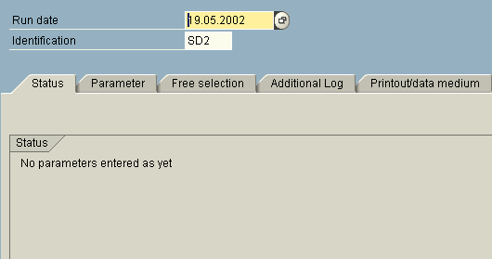
Maintaining Payment Parameters
Identifies each individual payment run
Status of the payment run
Notes:
Page <number>
HR
HR07: HR PAYROLL
You need to identify each payment run separately. There are two user definable fields that should be completed:
Run date.
Identification.
In the Run date field enter the actual date the payment is going to run.
In the Identification field enter your initials.

Slide 53
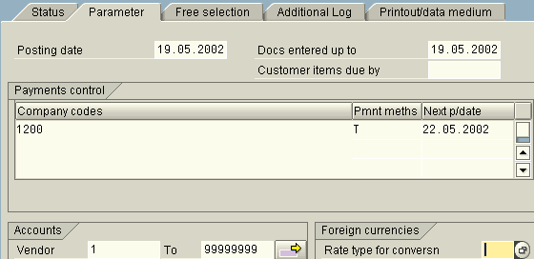
Payment Program Parameters
Which company codes are included?
Which payment methods?
Who’s being paid?
When is the
next run?
Notes:
Page <number>
HR
HR07: HR PAYROLL
Once the payment run is identified, the payment process can begin. In the first step of the payment process you need to define the following:
Who is going to be paid?
What payment methods will be used?
When will they be paid?
Which company codes will be considered?
How are they going to be paid?
This information is entered in the Parameters tab of the payment program.

Slide 54
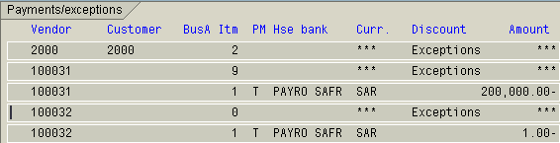
Proposal List
List of Vendors included in the run
Discounts/
Exceptions
Amounts included in proposal
Line Items
Payment Method
Currency
Bank details
Notes:
Page <number>
HR
HR07: HR PAYROLL
The proposal list details the vendors and the amounts to be paid per vendor. Depending on the line layout users choose for the screen, the associated document numbers and cash discounts can be displayed.
The proposal list contains a complete overview of all payments and the relevant line items. Any exceptions will be listed here as well. You can drill down several times to view and change the details of the individual payment items.
The end of the list contains a breakdown of the payment amounts sorted by business areas, countries, currencies, payment methods and banks.
You can view this information online or print it out.

Slide 55
Exception List
Items that cannot be paid are detailed on the exception list
Possible reasons:
  Invoice is blocked
  Invalid data in the master record
  Invalid payment method
  Invalid house bank
  Payment amount is less than the minimum amount specified for payment
  Not enough money in the house bank per configuration
Exception List!
Payment
Items
...
...
Total
Notes:
Page <number>
HR
HR07: HR PAYROLL
In addition to the proposal list, you can display or print an exception list. The exception list displays blocked items and all open items which the payment program did not propose for payment.
The reason for the exception is represented by an error number. The list includes an error text for every error reason.
All invoices that fall within the specified payment parameters but for some reason cannot be paid, will be listed on the exception list.
If users selected the additional log, the list will detail why the invoice is not eligible for payment.

Slide 56
Edit Payment Proposals
Payments
Items
Changing line items
Payment
Payment
Line Item 1
Payment
Items
Payment Method House Bank
Amount
...
Payment block
Payment
Item 1
Payment Method House Bank
Amount
...
Item 2
Discount
Payment
Payment Method House Bank
Amount
...
Item 3
Payment
Payment Method House Bank
Amount
...
...
Payment
Reallocate
Payment Method House Bank
Amount
...
Payment
Payment Method House Bank
Amount
...
Payment
Change payment
Payment Method House Bank
Amount
...
Create new payment or allocate item to existing payment
Account
Line Item 1
Amount
Payment method
Payment Method
House Bank
House Bank
Due Date
...
Notes:
Page <number>
HR
HR07: HR PAYROLL
Once the payment proposal is created, you can edit it online. Both payments and line items can be processed and edited.
It is therefore possible for several people to process extensive proposal runs in parallel. You can then use the display function to track what changes were made and who made them.
All changes made when editing the payment proposal affect only the payment proposal. No changes are made to the source documents.
In online editing of payments - you can view the details of a particular payment, add a payment block, change the payment terms, change the payment method, house bank and the due date of the invoice.
In online editing of line items - you can block or unblock line items, change the cash discount amount and allocate line items to another payment.

Slide 57
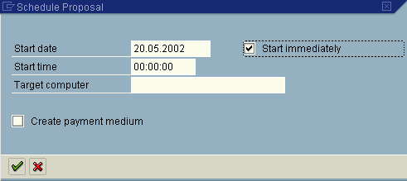
Schedule Proposals
Schedule a start time
- OR -
Choose this option to start immediately
Notes:
Page <number>
HR
HR07: HR PAYROLL
The proposal run:
searches the accounts and documents you entered in the parameters for due items
groups due items together to create payments
selects appropriate payment methods, house banks and partner banks for payment
A payment proposal list of the open items to be paid/collected in the next payment run is created. Items that cannot be paid/collected into the payment run are documented in an exception list.
The program selects open items for the payment proposal list. Criteria for selection of open item for payment are:
Item due date, calculated using baseline date and terms of payment
Company code-specific grace periods that are added to the due date
Date of the next payment run. This date is set up in the payment run. The program uses this date combined with the factors mentioned above to determine whether items should be paid in this or in the next payment run.
With these factors taken into account a proposal list is generated. The user can then edit the payment proposal log and the proposal list.

Slide 58
Payment Runs
Clear paid open
items
Post payments to
general ledger
Post related postings
for tax, discounts
Payment Run
Supply print program
with necessary data
Post related postings
for exchange rate
differences
Notes:
Page <number>
HR
HR07: HR PAYROLL
Once you have edited and accepted the proposal, you can plan the payment run. Several programs are used in creating the payments:
The payment program creates the payment documents and prepares the data for printing the forms or creating the tape or disk.
Various payment medium programs use the data prepared by the payment program to create forms or files for the data media.
In this step, payment documents are created, open items are cleared and postings are made against the general ledger and sub-ledgers.
The system creates a single clearing document for all the open line items in a vendor account, which are cleared against the payment.
The payment program posts payments and related postings such as those for tax, tax adjustments, exchange rate differences or cash discounts automatically.

Slide 59

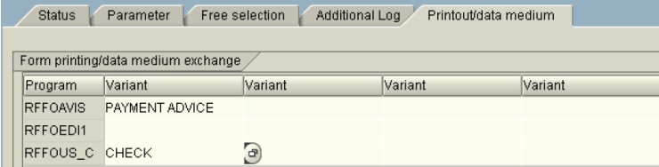
Printing Schedule - Checks
AP Department employee creates and posts payment run,
Checks & payment advices are printed
Enter
Variant & print checks
Notes:
Page <number>
HR
HR07: HR PAYROLL
The Accounts Payable personnel will prepare a payment proposal in SAP, edit it and take out a hard copy print-out for approval and a sign-off. The hard copy would be forwarded to an employee who has authority to carry out a payment run. The person who carries out the Payment run in SAP shall compare the details approved on the hard copy with the edited proposal pending in SAP and on his satisfaction about these being identical, shall carry out a payment run in SAP.
The system will post documents recording debit of the Vendor and crediting the Bank sub-account. The system has been set up so as to produce a Check (with a letter to the Vendor giving reference to payment document in the upper portion), a payment advice giving details of Vendor invoices being paid via the Payment document & a payment summary via the “Printout & DME Variant maintenance”.

Slide 60
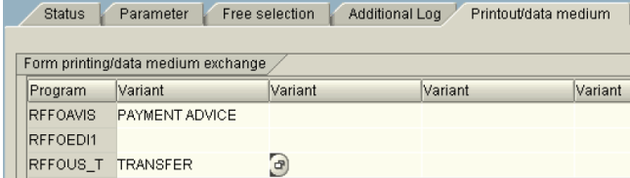
Print Program - Bank Transfer
AP Department employee creates and posts payment run,
Payment files & payment advices are generated / printed
Enter
variant
Notes:
Page <number>
HR
HR07: HR PAYROLL
The Accounts Payable personnel will prepare a payment proposal in SAP, edit it and take out a hard copy print-out for approval and a sign-off. The hard copy would be forwarded to an employee who has authority to carry out a payment run. The person who carries out the Payment run in SAP shall compare the details approved on the hard copy with the edited proposal pending in SAP and on his satisfaction about these being identical, shall carry out a payment run in SAP.
The system will post documents recording debit of the Vendor and crediting the Bank sub-account. The system has been set up so as to not to produce any DME data for download in the “Printout & DME Variant maintenance”. A payment advice & payment summary will be produced via the spool. The letter to be faxed to the bank for Transfer instructions is to be produced outside the system

Slide 61


Print Program - Bank Transfer
AP clerk creates and posts payment run,
AP manager creates electronic payment documents
Data is downloaded to a local file.
Create a local file - electronic pay. medium
Notes:
Page <number>
HR
HR07: HR PAYROLL
The Accounts Payable personnel will prepare a payment proposal in SAP, edit it and take out a hard copy print-out for approval and a sign-off. The hard copy would be forwarded to an employee who has authority to carry out a payment run. The person who carries out the Payment run in SAP shall compare the details approved on the hard copy with the edited proposal pending in SAP and on his satisfaction about these being identical, shall carry out a payment run in SAP.
The system will post documents recording debit of the Vendor and crediting the Bank sub-account. The system has been set up so as to not to produce any DME data for download in the “Printout & DME Variant maintenance”. A payment advice & payment summary will be produced via the spool. The letter to be faxed to the bank for Transfer instructions is to be produced outside the system

Slide 62
Payment Program - Reports
List of Spool Requests
Payment program generates several different outputs (like DME files, error logs, payment proposal list, payment settlement list etc.)
You can access those reports directly from Payment program menus or from AP/AR information system.
Some of the reports payment program generates automatically and you can access them from the spool (transaction SP02 or SP01).

Slide 63
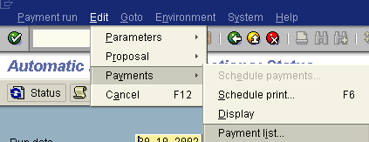
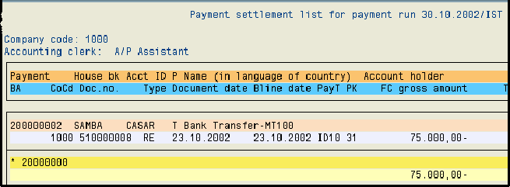
Payment Run - Print a List
Choose the relevant function from the main menu
Payment Settlement List
Notes:
This program has a similar functionality as that one that prints a list for payment proposal. The difference is that this list includes the documents included in payment run.
You can define your own variant for this program to define what details should be included in the output.

Slide 64
Accounts Payable Process Overview
Financial
Accounting
Process decompositions are the starting point for process documentation.
They summarise what is involved in a the AP process at a high level
Accounts Payable
Master
Data
Invoice
Processing
Sundry
Logistics
Payments / Disbursements
Account Analysis & Reconciliation
Periodic
Processing
Reporting

Slide 65
Account Analysis / Reconciliation
Business Transactions included in Process:
Accounts Balance
  Line Item display
Account Clearing
  Internal Post with Clearing
  Clearing with Customer
Notes:
Page <number>
HR
HR07: HR PAYROLL

Slide 66

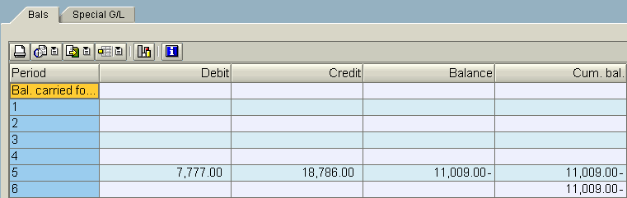
Display Account Balance
Account balance displays totals of transactions, per month as well as cumulative values
The report may be printed or saved as a local file

Slide 67

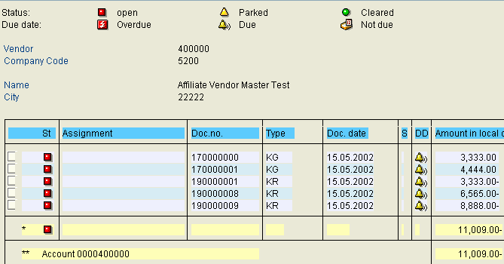



Display Account Line items
“Line items” report displays particular transactions,
It it possible to change the documents directly from this screen,
The report may be printed or saved as a local file

Slide 68


Open Item Clearing
2
1
February
Open item account
January
1
2
3
4
5
6
7
2,000
5,000
1
2
3
4
5
6
7
8
9
10
11
12
13
14
8
9
10
11
12
13
14
16
17
18
19
20
21
22
3,000
16
17
18
19
20
21
22
23
24
25
26
27
28
29
23
24
25
26
27
28
29
29
30
31
29
30
31
Invoice
Goods receipt
Can be cleared
3
Clearing an account
Post with clearing
Notes:
Page <number>
HR
HR07: HR PAYROLL
Open items are incomplete transactions, such as an invoice for which goods or services have not yet been received.
In order for an open item transaction to be considered complete, the transaction must be cleared. A transaction is considered cleared when an offset value is posted to it, so that the resulting balance of the items is zero.
In the above example:
1.A goods receipt is posted to the GR/IR account.
This goods receipt is regarded as an open item because at this point the corresponding invoice has not been received.
2.The invoice is received and the goods receipt is set off against it.
3.The transaction is now cleared and the resulting balance is zero.

Slide 69
Clearing Open Items Manually
1 Invoice 1000
2 Credit memo 1000
?
Clearing account
1 1000 1000 2
Notes:
Page <number>
HR
HR07: HR PAYROLL
You can use manual clearing to clear debits and credits on vendor accounts which balance to zero (for example, invoices and payments which have already been entered).
Manual clearing can only be done against a single vendor account in a specific company code. This means that you have to clear each vendor account separately.
You need to enter the vendor account number and company code on the initial clearing screen. The clearing date is proposed by the system, but can be changed by the user.
You have the option of searching for specific items to clear, for example, you can enter a range of document numbers, posting dates or transaction amounts.
When you process open items manually, you can activate or deactivate open items and cash discounts, maintain cash discount amounts and enter partial payments or residual items.
You process the open items by choosing the relevant debit and credit entries and then activating the open items.
The system assigns the clearing date and a clearing document number to each cleared open item.

Slide 70
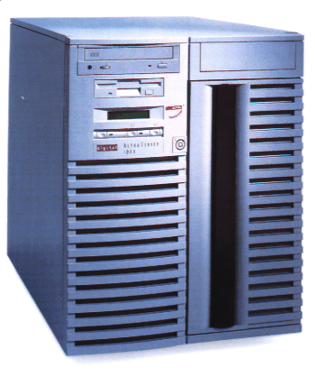

Automatic Clearing Program
Accounts
xxxxxx
xxxxxx
xxxxxx
xxxxxx
----
----
----
----
----
----
----
----
----
----
----
----
----
----
----
----
----
----
----
----
----
----
----
----
----
----
----
----
----
----
----
----
----
----
----
----
----
----
----
----
Automatic clearing program
Recon acc. 160000
Clearing document
Recon acc. 160100
Ref no.
Amount
Ref no.
Amount
Clearing document
5287
5000 -
16978
1500 -
5287
7000 -
16978
3200 -
5287
12000 +
16978
4700 +
Ref no.
Amount
Clearing document
Ref no.
Amount
Clearing document
425
2500 -
9624
7500 -
425
2500+
9624
7500+
Notes:
Page <number>
HR
HR07: HR PAYROLL
You can clear open items using the the automatic clearing program. The program groups together items from an account that have the same reconciliation account number, currency, and Special G/L indicator, as well as pre-defined criteria from the document header or item such as the allocation field, reference number and amount.
For A Ltd the external invoice reference number has been defined as an assignment field.
If the balance, in local currency, of the items within a group is zero, the system automatically clears them and creates clearing documents.
Prerequisites for using the automatic clearing program:
Accounts must be managed on an open item basis.
Accounts to be cleared must be defined in customizing.
The automatic payment program does not clear noted items, statistical posting, down payments, bills of exchange and items with withholding tax entries.
When clearing open items in a foreign currency, differences may occur due to fluctuations in exchange rates. The system automatically posts these differences as realized gains or losses.

Slide 71
The Clearing Document
Open Item Account
40000
10000
50000
20000
Clearing document
Amounts can be cleared
Notes:
Page <number>
HR
HR07: HR PAYROLL
The system creates a clearing document even when no clearing entries are necessary. The clearing number is derived from the document number of the clearing document.
A clearing document is created in all cases, including when doing manual clearing and running the automatic clearing program.
When doing posting with clearing, you can enter a text in each clearing transaction. This text is copied to every clearing document that is created when clearing the open items.
An extra reference number or text can be entered in the header of the clearing document before or after the document has been posted.
One of the advantages of the clearing document is the higher transparency when viewing cleared items.
The user ID of the person who cleared the open items is recorded, which provides a higher degree of security.
When no line items are created in the clearing process a document is still created containing the header data. From the header data you can view the accounts in which items were cleared.
You can define a default document type for clearing documents, which will improve searching for and reporting on clearing documents.

Slide 72
Clearing: Vendor and Customer
1 Customer invoice 46,000
2 Vendor invoice 20,000
3 Customer payment 26,000
Customer ABC Inc.
Vendor ABC Inc.
1 46,000 46,000 3
3 20,000 20,000 2
Bank
3 26,000
Notes:
Page <number>
HR
HR07: HR PAYROLL
If you select a vendor who is also a customer when processing a clearing transaction, such as an incoming/outgoing payment or account maintenance, the system will also select the open customer items automatically, provided that:
The customer number was entered in the vendor master record.
The “Clearing with customer / vendor” indicator has been set in both master records.
When posting payments to these vendors, the system will display the customer open items in addition to the vendor open items.
You must have authorization to post in both Accounts Receivable and Accounts Payable transactions, in order to clear customers and vendors against each other.

Slide 73

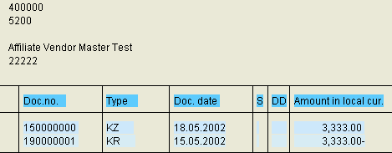
Reversal of Clearing
Display of cleared items
Reversal of clearing
Reversal of documents that have been cleared before is not possible,
First the clearing operation must be reset and then you can reverse a document.

Slide 74
Accounts Payable Process Overview
Financial
Accounting
Process decompositions are the starting point for process documentation.
They summarise what is involved in a the AP process at a high level
Accounts Payable
Master
Data
Invoice
Processing
Sundry
Logistics
Payments / Disbursements
Account Analysis & Reconciliation
Periodic
Processing
Reporting

Slide 75
Periodic Processing
Business Transactions included in Process:
LIV invoice variances
  Invoice differences
  Blocked invoices
  Tolerances (not configured)
GR/IR Account Maintenance
Vendor Correspondence
  Standard Letters
  Balance Confirmation
Notes:
Page <number>
HR
HR07: HR PAYROLL

Slide 76
Invoice Variances (AP-MM integration)
Quantity
Price
Goods Receipt
Vendor Invoice
Purchase order price quantity
Date
The system carries out the following checks for each invoice item:
  Quantity variance
  Price variance
  Purchase order price quantity variance
  Date variance
Notes:
Any variances in the invoice items will result in invoice blocking
Using the transaction “Invoice overview” you can display the blocking reasons.

Slide 77
GR/IR Account Movements
Purchase order
Goods Receipt
Invoice
97 pcs
@ 10.00 USD
100 pcs
@ 10.00 USD
100 pcs
Goods Receipt
Invoice
GR / IR Account Maintenance
Stock account
1,000 +
30 -
GR / IR account
1,000 -
970 +
30 +
Vendor Account
970 -
Notes:
An open item is created on the GR/IR account as a result of the difference between the delivered quantity and the invoice quantity.
If no further invoice is received (or return delivery created), the open item must be cleared manually.
The stock account is credited or debited as a result of the clearing of the GR/IR account. For a material with moving average price, the stock account is only credited or debited if there is sufficient stock coverage. Therefore the system contains a price difference account.
You can reverse this document

Slide 78
GR/IR Quantity Variances
Invoice
Purchase order
Goods Receipt
80 pcs
@ 10.00 USD
100 pcs
@ 10.00 USD
50 pcs
Goods Receipt
30 pcs
The GR/IR clearing account is cleared for a purchase order item when the delivered quantity and the invoice quantity are the same.
In this example the invoice quantity is greater than the delivered quantity, the system expects another goods receipt.

Slide 79
GR/IR Quantity Variances (2)
Invoice #1
Purchase order
Goods Receipt
97 pcs
@ 10.00 USD
100 pcs
@ 10.00 USD
100 pcs
Invoice #2
3 pcs
@ 10.00 USD
In this example the delivered quantity is greater than the invoice quantity, the system expects another invoice.
Any differences in the GR/IR clearing account must be cleared. If the differences are not cleared by another goods receipt (or a return delivery) or by an invoice (or a credit memo), the GR/IR clearing account must be maintained manually.
Notes:
Caution: Before maintaining the GR/IR clearing account, you should establish that no further goods receipts or invoices are to be posted for a purchase order item.

Slide 80
Releasing Blocked Invoices
An invoice is blocked for payment when you post it, because the Payment block indicator is selected in the vendor line item of the invoice document. Financial Accounting is then unable to pay the invoice.
A blocked invoice can be released for payment in a separate step. This deletes the payment block.
An invoice is also blocked when the variance between goods receipt and an invoice exceeds tolerance limits.
The invoice will not be blocked if the variance is within certain tolerance limits.

Slide 81
Releasing Blocked Invoices (2)
Make selection
Define processing
Automatic release
Manual release
The blocked invoices can be released.
In the time between the blocking and releasing of an invoice, the cash discount period could expire. When you release an invoice, you have the opportunity to change the baseline date for payment.
You can define whether you want to release the invoices manually or automatically via the field Automatic release.

Slide 82
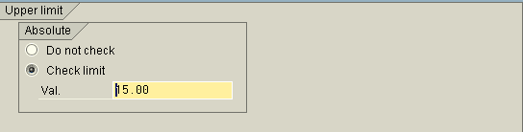
Tolerances
In every company code there defined tolerances for:
  Quantity variance
  Price variance
  Purchase order price quantity variance
  Date variance
In the case of quantity variance the system checks purchase order price vs. quantity variance (the greater the purchase order price, the lower the tolerated quantity variance)
In the case of schedule variance the system checks invoice value vs. days variance (the greater the invoice value, the lower the tolerated schedule variance).

Slide 83
Requesting Correspondence
Correspondence request
Mass request
selection program
Individual request
manual
Individual request
automatic
Open item list
Bill of exchange settlement
Standard letter
Account statement
Internal documents
Individual correspondence
Periodic account statement
Payment notice
Corre-spond-ence requests
Trigger report
Print programs
Notes:
Page <number>
HR
HR07: HR PAYROLL
Correspondence types differ with respect to the contents and structure of the letters you can send to your business partners. There are various types of correspondence in the SABIC R3 System.
The account statement is an extract from the vendor account which enables him to check the items there. The account statement displays the balance carried forward, all items in the chosen period and the closing balance of the account.
You can use document extracts to inform your vendor about specific line items (for example a credit memo).
You can use payment notices to inform your business partners which open items have been cleared with received payments. If payments have been made which you cannot allocate to open items, you can ask your business partner to specify for which item the payment was made. The payment notices are usually printed with checks or bank transfer payments.
Periodic correspondence is triggered by settings made in the master data (collective invoice, account statement). For this type of correspondence you can define time variants (weekly, monthly).

Slide 84



Balance confirmation
Letter to the Vendor
Vendor Reply to the Sender
Open items
200.00-
354.00
126.20-
…….
This function enables you to create and print letters to the Vendors for checking the open items.
System prints also a necessary reply form, so a Vendor can confirm the outstanding items or specify the differences.

Slide 85
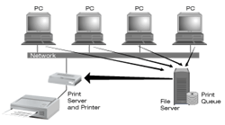
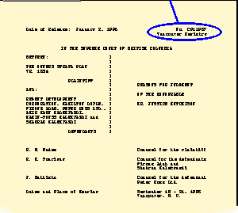


Correspondence: Output Type
Printer
Email
Fax
Notes:
Page <number>
HR
HR07: HR PAYROLL
Correspondence types requested in different functions can be printed centrally. Various selections can be made for printing them.
You can print individual correspondence types directly from the menu. Make the usual selections and specifications.
To create periodic account statements, you need to define a periodic indicator in the vendor master.
There are a number of correspondence types already defined in the system. You can set various parameters for them.
You can allocate the print program, a variant and a text default to the individual correspondence types. You can make different settings for each company code at this level.
You can set up different forms for each individual correspondence type in the same way as dunning forms. You then can allocate these forms to the print programs. If necessary, the form allocation can be made at company code level.
Each print program requires a variant. An output device must be defined in this variant.

Slide 86
Accounts Payable Process Overview
Financial
Accounting
Process decompositions are the starting point for process documentation.
They summarise what is involved in a the AP process at a high level
Accounts Payable
Master
Data
Invoice
Processing
Sundry
Logistics
Payments / Disbursements
Account Analysis & Reconciliation
Month
End
Processing
Reporting

Slide 87
Reporting
Business Transactions included in Process:
Standard Reports
  Open Items List
  Cleared Items List
  Account List
  Account Balance List
  Vendor Evaluations
Customised Reports
  Aged Open Items List
Notes:
Reporting Tools applicable to Payroll Administration are:
Standard Reports (Human Resources Information System)
Ad Hoc Query
Custom-built Reports

Slide 88
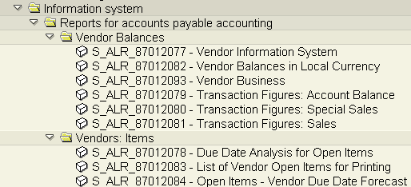
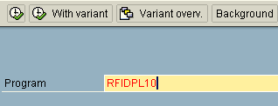
Accessing Reports
1
SAP Menu
2
Transaction SA38
A user can run the required report in two ways:
  Directly from “The Report Tree”,
  Using transaction SA38, provided that he/she knows the report’s name
Notes:
Every report can be either printed or displayed on the screen.

Slide 89
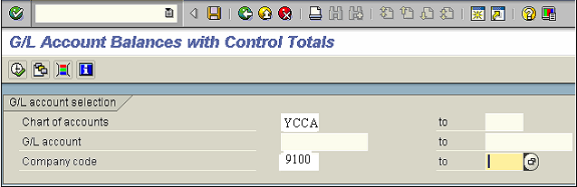
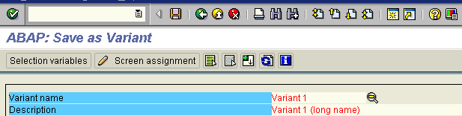
Report Variant
1) Enter the required criteria on the selection screen
2
1
2) Click “Save” button
3) Enter the variant’s name
3
Notes:
Several report variants can be created for a single report so that different users can access the same report with their own specific data
Report variants allow user to access the required data quickly and easily

Slide 90
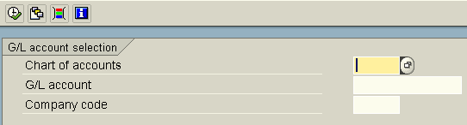
Report Execution
Report Execution
Selection of Report Parameters
Variant Selection
Dynamic selection
A report can be executed directly or scheduled in the background

Slide 91
Accounts Payable Evaluations
Evaluation Views
Company code
- Corporate group
Variable
Business area
- Company code
Country
- Business Area
Planning group
Due date analysis
Currency analysis
Overdue items
Recon. Acct.
Versions
Evaluation types
Notes:
Page <number>
HR
HR07: HR PAYROLL
The accounts payable information system enables you to access different evaluations already defined in the system. Because these evaluations are stored in an information database, system response times are accelerated.
The results stored in the information database are based on the last evaluation carried out. You can update the evaluations at regular intervals.
In customising, there are defined various parameters for selecting and summarising evaluation data according to your own needs.

